Slide 1
Madera Transit Analysis
Ralph Cuevas

Slide 2
Introduction
I began this project with the desire to understand more about the City of Madera, California’s transit system after living in Pomona, California for a few years.
I wanted to understand the context of how the system has operated over a significant span of time. After gathering NTD (National Transit Database) files from 2014-2024, I found that the trends within the data paint a unique picture of the system’s history. Spatial Geographic visualizations via QGIS also provides context for how the Fixed Route system serves the city.
Acronyms will be explained as they appear on each slide along with a glossary found at the end of the deck.

Slide 3
QGIS Route Overview
The following section focuses on visualizations designed to provide context on Madera's population and identifying potential expansion/improvement opportunities

Slide 4
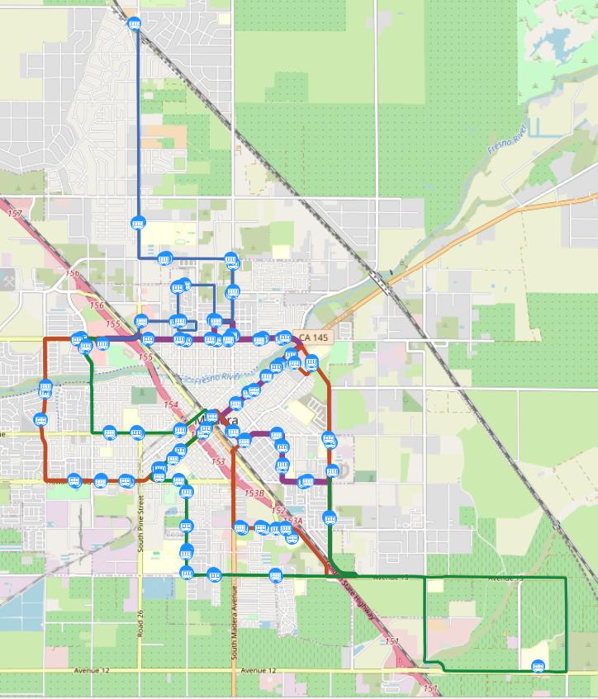
Fixed Route Overview
The City of Madera runs a fixed route system comprised of 4 routes that run hourly or every half hour depending on the route
The Purple line is in service from 7am-5:30pm, the Orange line from 7am-5am, the Green line from 7:15am-5:15, and the Blue line from 9am-4pm
Of the four routes, only the Purple and Orange lines run on weekends on a limited schedule
The routes connect to major commercial areas such as shopping centers as well as the Madera Amtrak station and hospital
While usable, low frequency and limited schedules limit the FR systems use in day-to-day activities or as a work commute option

Slide 5
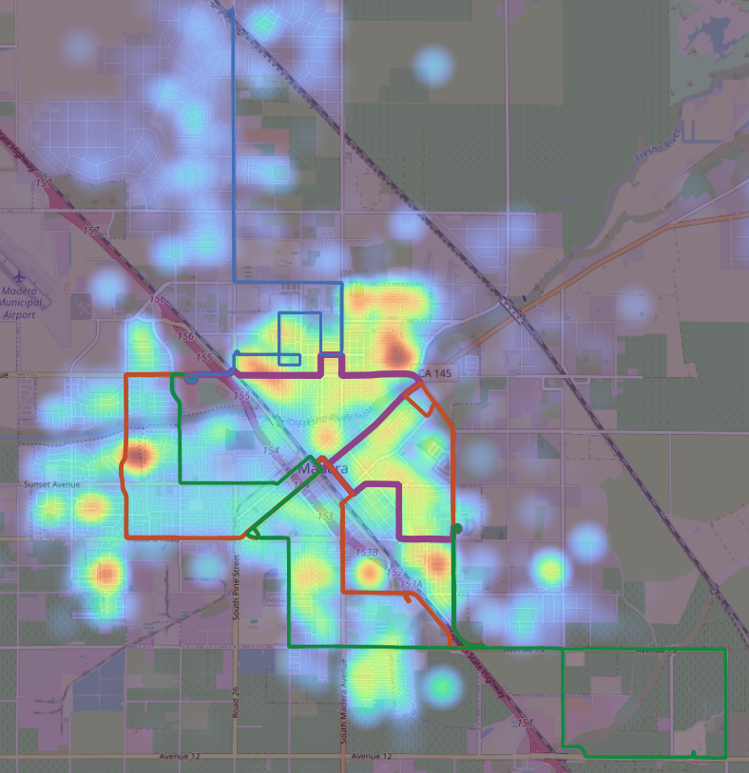
Population Overlay
Using QGIS, I used publicly available census data to create a heatmap that visualizes the major population clusters in the city.
While not exceptionally precise this helps provide an at a glance view of where the transit system is situated relative to the population
The system has wide coverage and overlaps well with populous areas, signaling potential for multiple arterial corridors, especially downtown.
For applications and analysis that requires more precision, I prepared a visualization that shows data at a neighborhood scale on the next slide.

Slide 6
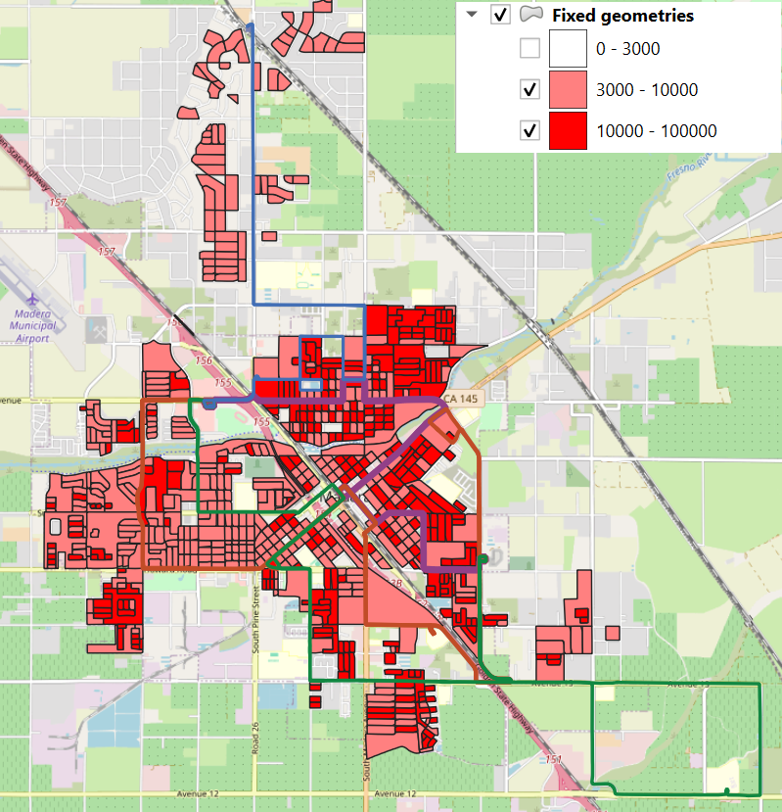
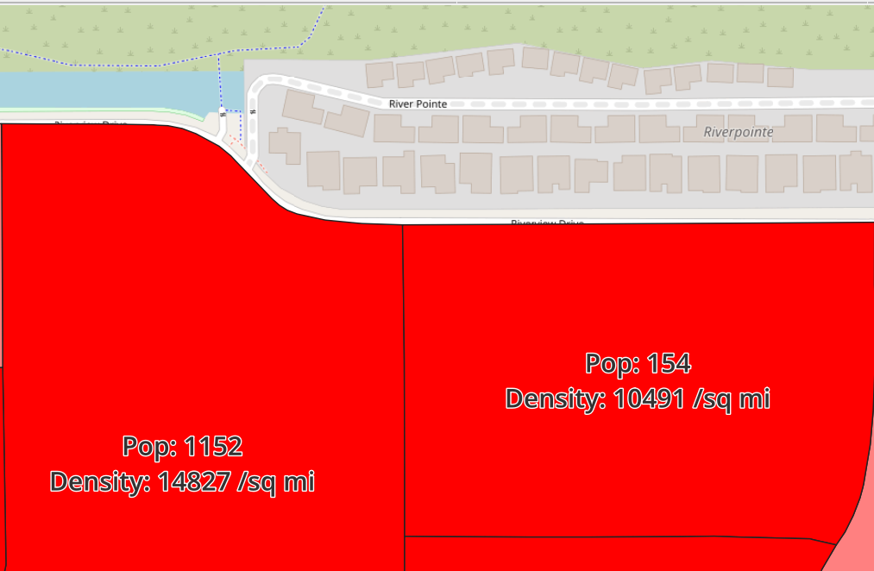
Population Density Overlay
This visualization takes advantage of the city’s population block data to provide population density data with a very high level of precision
In this configuration, the visualization only shows blocks where the population density is above 3000 people per square mile. Anything less is left transparent, leading to a fragmented view of the city.
The dark red blocks have a density of at least 10,000 per square mile, a common tipping point where high frequency transit (15-minute intervals) is considered viable.
I also took advantage of QGIS to make it so that when the map is zoomed in to a block, it’s population density and total population is displayed
Click to toggle to and from zoomed in view

Slide 7
NTD Data Visualization
The following section focuses on interpreting NTD (National Transit Database) data to identify potential pain points and areas for improvement in financial and service contexts

Slide 8
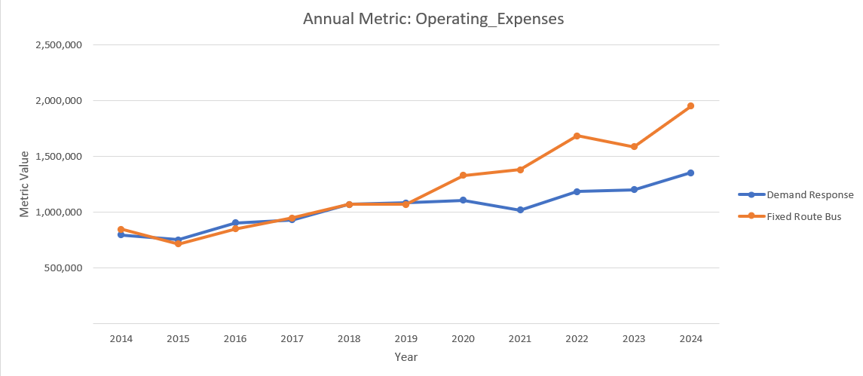
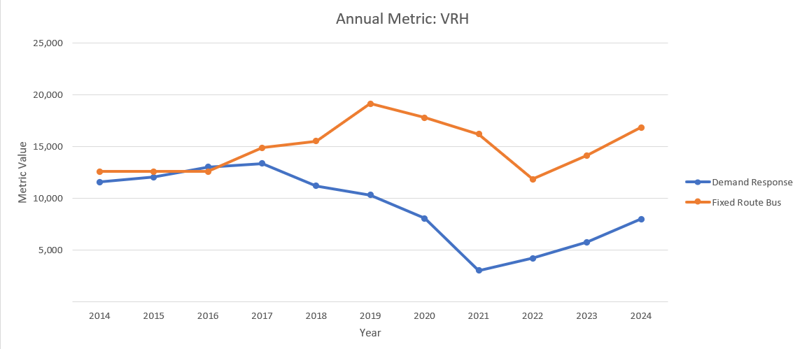
Operating Expense and Usage Trends
The data shows an increase in Operating Expenses year-by-year with a major split between Fixed Route (FR) buses and Demand Response/Dial-a-Ride (DR) occurring in 2020 which persists through 2024 with a difference of nearly $600K in expenses going towards Fixed Route.
VRH or Vehicle Revenue Hours are the hours in which a vehicle travels while in service. The data shows that Fixed Route Buses began to run for more hours in 2016 with an average of nearly 7,800 more hours per year since then.

Slide 9
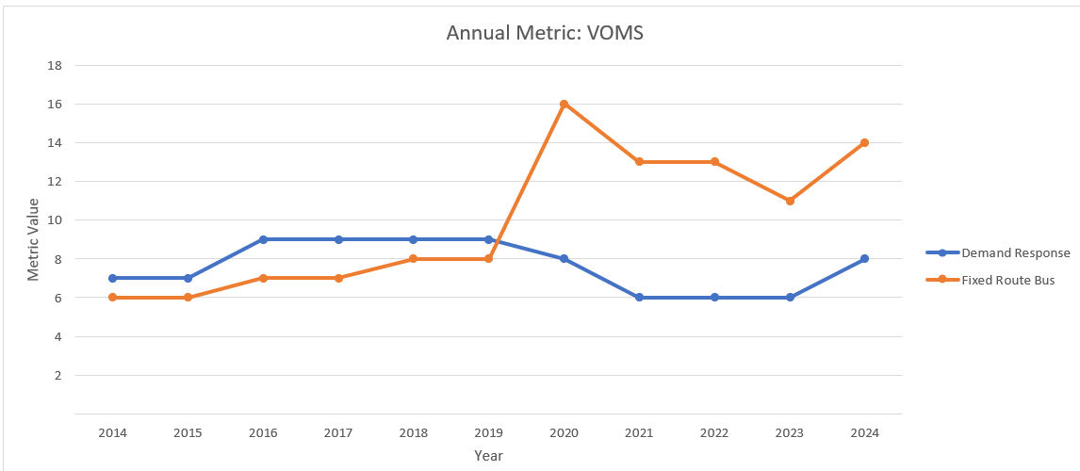
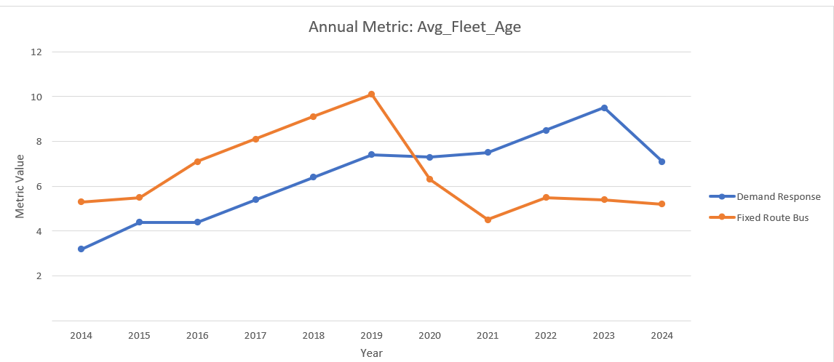
Increased Service
VOMS or Vehicles Operated in Annual Maximum Service is a metric that describes the number of vehicles an agency needs to operate in its peak-season schedule. Here we can see a dramatic increase in the vehicles in use in 2020 from 2019. Doubling the number of FR vehicles in service.
The average fleet age also dropped dramatically, which aligns with vehicle acquisitions made in 2020.
Unfortunately, this expansion of service coincided with COVID-19 which dramatically impacted the ridership in Madera as shown by the next set of charts.

Slide 10
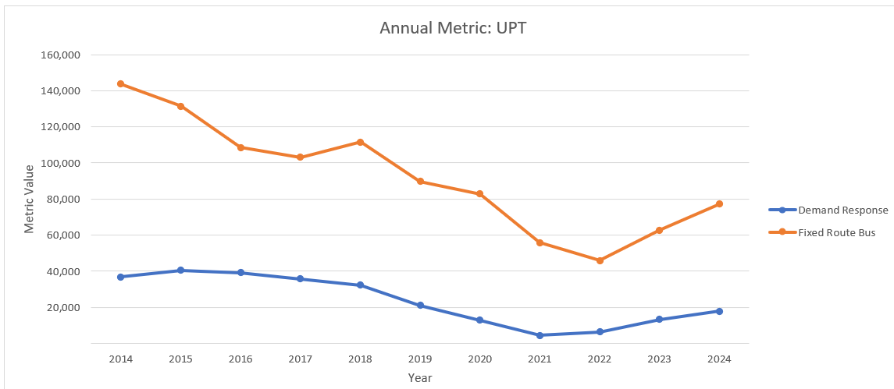
Ridership
UPT or Unlinked Passenger Trips is a metric that counts how many passengers ride a vehicle regardless of any transfers. Here we can see the sheer difference in the number of passengers that FR moves compared to DR. We can also see that ridership was affected significantly by COVID with ridership still below pre-COVID numbers and about half what it was in 2014 but is recovering at a good rate.
While FR has the higher VRH, UPT, and VOMS which all drive up OE(Operating Expenses). The nature of DR causes it to have a staggering cost compared to FR, as we’ll see next.

Slide 11
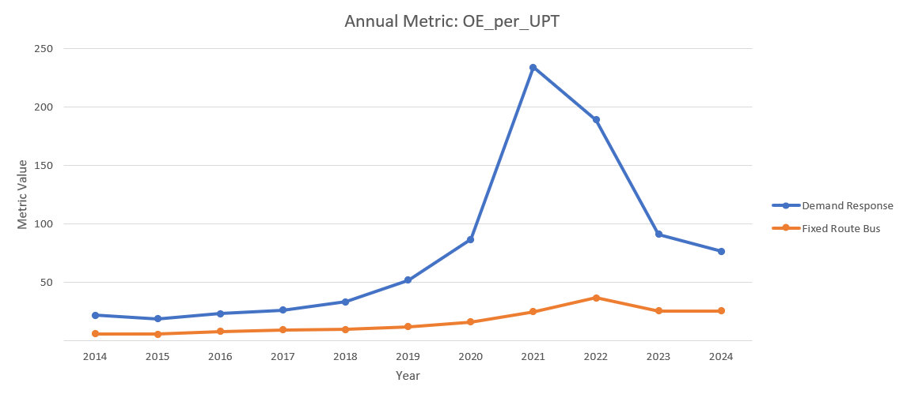
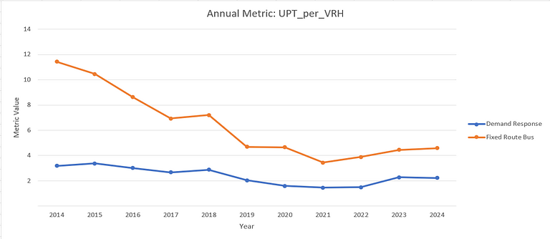
Operating Expenses at a Reduced Scale
OE per UPT is essentially the cost to The City Of Madera’s transit agency to transport one person to their destination. While UPT per VRH is the amount of people transported per hour of service. Here we can see that there is a massive difference in cost per UPT in 2021 which carries through cost per VRH as well.
As of the most recent NTD report (2024) it costs $76.44 per trip via DR compared to $25.25 for FR. This is likely due to DR running on pre-planed or real-time passenger bookings which will lower ridership compared to a bus with a fixed schedule and higher capacity.
A recovering rider base for FR signals potential for improvements proving fruitful in further increasing ridership, more practicality can allow for greater economic stimulation which can indirectly offset the higher upfront cost, and bolster the negligible farebox recovery.

Slide 12
Conclusion
After analyzing the data, I feel the biggest concern with Madera’s transit system is its impracticality as a meaningful alternative to personal vehicles. I believe it is time to explore addressing infrastructure gaps with higher-frequency service in mind. However, with the hourly bus service and negligible farebox recovery there is real work to be done.
The City is currently exploring micro-transit as an alternative to DR and potentially FR, while it can work well for smaller communities. I worry that pursuing more low-density transit could hamstring transit-oriented developments in the future.
With the future of the Bay Area and Los Angeles connections of California’s HSR in flux, banking on its associated benefits may spread the City’s resources thin. With that said, Madera should still take steps to explore service improvements to take advantage of inter-city travel within the Central Valley.
I’d recommend exploring the implementation of pilot programs for higher frequency schedules in major corridors and gauging the viability of microtransit replacing the current DR Dial-A-Ride service.
In regards to improvements to this project, per-route data would have aided in analyzing which routes serve as major corridors or if any route revisions would need to be made.

Slide 13
Glossary
(Underlined definitions are abridged from the NTD website)
QGIS: a free, open-source Geographic Information System (GIS) software. It allows users to create, edit, visualize, analyze, and publish geospatial information on Windows, macOS, and Linux.
Fixed Route Services (FR): Services provided on a repetitive, fixed schedule basis along a specific route with vehicles stopping to pick up and deliver passengers to specific locations; each fixed route trip serves the same origins and destinations, such as rail and bus (MB); unlike demand responsive (DR) and vanpool (VP) services.
Demand Response (DR):A transit mode comprised of passenger cars, vans or small buses operating in response to calls from passengers or their agents to the transit operator, who then dispatches a vehicle to pick up the passengers and transport them to their destinations. A demand response (DR) operation is characterized by the following: a) The vehicles do not operate over a fixed route or on a fixed schedule except, perhaps, on a temporary basis to satisfy a special need, and b) Typically, the vehicle may be dispatched to pick up several passengers at different pick-up points before taking them to their respective destinations and may even be interrupted en route to these destinations to pick up other passengers.
Vehicle Revenue Hours (VRH): The hours that vehicles are scheduled to or actually travel while in revenue service. Vehicle revenue hours include: layover / recovery time. Vehicle revenue hours exclude: deadhead, operator training, Vehicle maintenance testing, and other non-revenue uses of vehicles.
Vehicles Operated in Annual Maximum Service (VOMS): The number of revenue vehicles operated to meet the annual maximum service requirement. This is the revenue vehicle count during the peak season of the year; on the week and day that maximum service is provided. VOMS exclude: atypical days; or one-time special events.
Unlinked Passenger Trips (UPT): The number of passengers who board public transportation vehicles. Passengers are counted each time they board vehicles no matter how many vehicles they use to travel from their origin to their destination.

Slide 14
References
Mobility Database — Madera GTFS Feed: https://mobilitydatabase.org/feeds/gtfs/mdb-91
Madera County GIS: https://www.maderacounty.com/government/geographic-information-system-gis
Madera Metro System Map and Schedule: https://www.madera.gov/media/4oml3tfu/01-madera-metro-system-map-and-schedule-rev-240220-1.pdf
NTD Glossary: https://www.transit.dot.gov/ntd/national-transit-database-ntd-glossary#V
NTD Data — Annual Data: https://www.transit.dot.gov/ntd/ntd-data?field_product_type_target_id=1026&year=all&combine=

